Slide 1
EMOTION BASED MUSIC RECOMMENDER USING MACHINE LEARNING
Team Members ​
A.Rushmitha(22AG1A6770)​
Huda Nazneen(22AG1A6792)​
S.Pradeep(22AG1A67B6)​
V.Sai Prabhas(22AG1A67C5)​
​
Project Guide​
Mrs.T.Swathi
Assistant Professor
CSE(Data Science)

Slide 2
Table of Contents
Abstract
• Introduction
• Existing System
• Proposed System
• Software & Hardware Requirements
• Functional & Non Functional Requirements
• Software and Hardware Requirements
• System Design
• References

Slide 3

ABSTRACT:
People often express their emotions through facial expressions. Music is a powerful tool that can influence and improve a person’s mood. This project aims to detect a person’s emotion—either through facial expressions or manual text input and recommend songs that match their mood, creating a calming and enjoyable experience.The system uses a webcam to capture the user's facial expressions and applies image processing techniques to analyze facial features. With the help of a trained deep learning model, it identifies the user’s emotion—such as happy, sad, angry, or surprised. Alternatively, users can also manually enter their current emotion through a text input option. Based on the detected or entered emotion, language preference, and selected music platform, the system suggests suitable songs. For example, it may suggest pop and dance songs for happy moods or soft rock and acoustic songs for sad moods etc.

Slide 4
INTRODUCTION
The Emotion-Based Music Recommender is a smart application that uses machine learning to suggest music based on a person’s emotional state. It can detect emotions either through real-time facial expressions using a webcam or through manual text input. By analyzing features like facial and hand landmarks using MediaPipe, and predicting emotions with a trained machine learning model, the system identifies how the user is feeling — such as happy, sad, angry, or surprised.
Once the emotion is detected, the app recommends suitable music by searching for songs on platforms like YouTube, Spotify, or Apple Music. Users can also choose their preferred language for the music. This system makes music more personalized and enjoyable by connecting emotions to sound, helping users find the right music for their mood with just a few clicks.

Slide 5
EXISTING SYSTEM
1. EMO-MUSIC: Facial Expression-Based Music Recommendation System
Limitations:
Works only with facial expressions, by captured image.
Limited to predefined playlists, not personalized.
2. DeepEmotion: Deep Learning-Based Emotion and Music Recommendation System
Limitations:
Requires a good-quality of webcam for accurate emotion detection.
High computational power needed for real-time deep learning processing.
EEG-Based Emotion Recognition and Music Recommendation System
Limitations:
Requires specialized EEG hardware.
High cost and complexity in setup.

Slide 6
PROPOSED MODEL:
1.Multi-Modal Emotion Recognition
Uses Deep Learning (CNN for Face, LSTM for Speech, SVM/KNN for EEG signals).
Ensures higher accuracy in real-time emotion detection.
2.AI-Driven Personalized Music Recommendation
Uses a Hybrid Filtering Approach (Collaborative + Content-Based Filtering).
Learns user preferences using Reinforcement Learning (RL) for adaptive recommendations.
Fetches real-time music recommendations from Spotify, YouTube, or Apple Music API instead of static playlists.
3.Real-Time Processing & Cross-Platform Support
Optimized ML models ensure low latency for real-time use.
Available on Web, Mobile, and Desktop .
4.User Feedback & Continuous Learning
Takes user feedback after each song to fine-tune recommendations over time.
Uses Reinforcement Learning (RL) to improve music selection based on emotional shifts.

Slide 7
FUNCTIONAL REQUIREMENTS:
Real-Time Video Capture: The system shall capture real-time video from the user's webcam to analyze facial expressions.
Facial Landmark Detection:The system shall use Mediapipe to detect facial landmarks from the video frames.
Emotion Prediction:The system shall use a pre-trained Keras model to predict the user's emotion based on the detected facial landmarks.
Manual Emotion Input:The system shall allow users to manually enter their emotion via text input as an alternative to automatic detection.
Emotion-Based Music Recommendation:The system shall recommend songs that match the detected or manually entered emotion.

Slide 8
Music Platform Integration:The system shall open the selected music platform(YouTube,Spotify,or Apple Music)in the default web browser using an emotion-based search query.
User Feedback Collection:The system shall allow users to provide feedback on whether the detected emotion was accurate.
Adaptive Prediction Adjustment:The system shall store feedback data locally and use it to improve future emotion prediction accuracy.

Slide 9
NON-FUNCTIONAL REQUIREMENTS:
Video Performance: The system shall maintain a video frame update rate of at least 30 frames per second to ensure smooth real-time detection.
User Data Privacy: The system shall ensure user data privacy by storing feedback only on the local machine,with no external data transmission.
User Interface Usability: The system shall provide a clean,responsive,and intuitive graphical user interface(GUI)using PyQt5.
Error Handling: The system shall handle common errors gracefully,such as unavailable webcam or failure to load the model,and notify the user appropriately.
Cross-Platform Compatibility:The system shall be compatible with major operating systems(Windows,macOS,and Linux)that support Python and PyQt5.
Low-Latency Feedback:The system shall process user input and provide emotion detection results within one second to ensure responsiveness.

Slide 10
SOFTWARE REQUIREMENTS:
Operating System: Windows 10/11,macOS,or Linux(with GUI support)
Programming languages: Python
IDE: Jupyter Notebook
Libraries and Packages:
TensorFlow/PyTorch for model training
OpenCV for image processing
SQL/NoSQL database for storing user preferences
Web/Mobile framework for UI (React, Flask, Android, etc.)
JSON Module:for storing and retrieving user feedback data.

Slide 11
HARDWARE REQUIREMENTS:
Webcam:A functional webcam with at least 640x480 resolution to capture user facial expressions.
Processor:Minimum Intel Core i3 or equivalent to handle real-time video processing and model inference.
Memory:Minimum 4 GB RAM for smooth operation.
Storage:At least 100 MB free space for installing dependencies and storing feedback files.

Slide 12
SYSTEM ARCHITECTURE:
1. Face Detection using Webcam
The system captures the user's face using a webcam.
It detects the presence of a face in real-time.
2. Facial Landmark Extraction
Key facial landmarks (e.g., eyes, eyebrows, mouth) are extracted.
These landmarks help in determining facial expressions.
3. Facial Expression Detection
Using deep learning or computer vision techniques, the system
analyzes the facial landmarks.
It classifies the detected facial expressions into one of the predefined
categories (Angry, Disgusted, Fearful, Happy, Neutral, Sad, Surprised).
4. Music Player
Based on the detected emotion, the system selects an appropriate playlist or song.
The music player plays the song that matches the user's emotional state.
5. Emotion-Based Music Selection
If the user is Happy, upbeat or energetic songs are played etc..

Slide 13
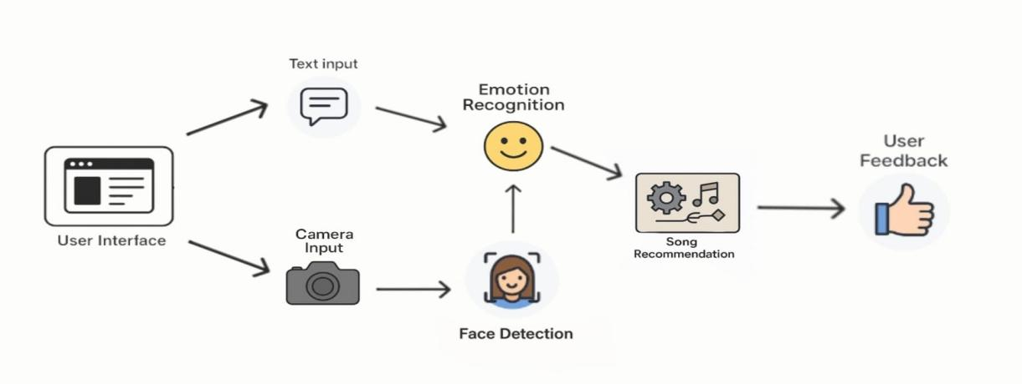
SYSTEM ARCHITECTURE:

Slide 14
UML DIAGRAMS:
UML stands for Unified Modeling Language, and it's a visual representation that helps in designing and documenting software systems.
UML diagrams are used to depict different aspects of a system, such as its structure, behavior, and interactions.
With UML, you can create diagrams such as class diagrams, which show the classes and their relationships in a system; sequence diagrams, which depict the interactions between objects over time; and activity diagrams, which illustrate the flow of activities or processes within a system.

Slide 15
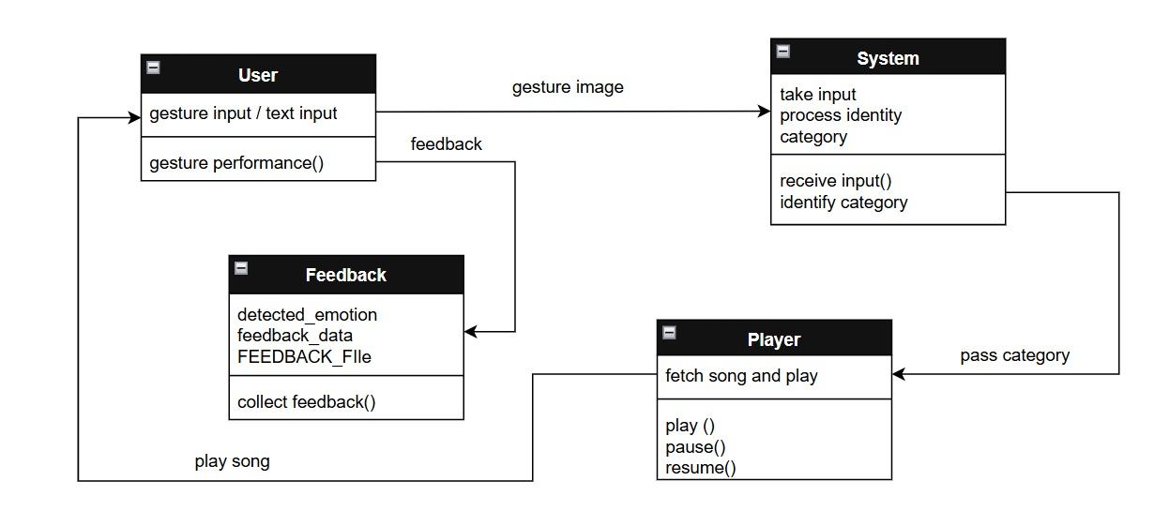
CLASS DIAGRAM:

Slide 16
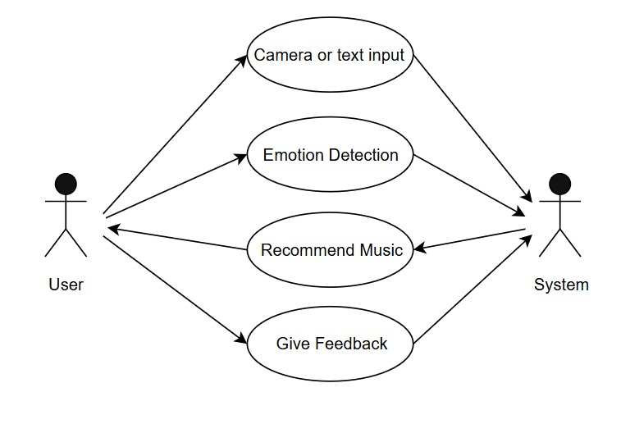
USE CASE DIAGRAM:

Slide 17
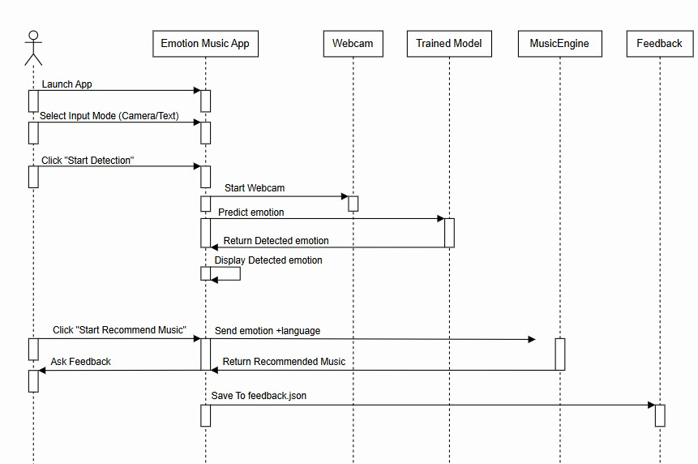
SEQUENCE DIAGRAM:

Slide 18
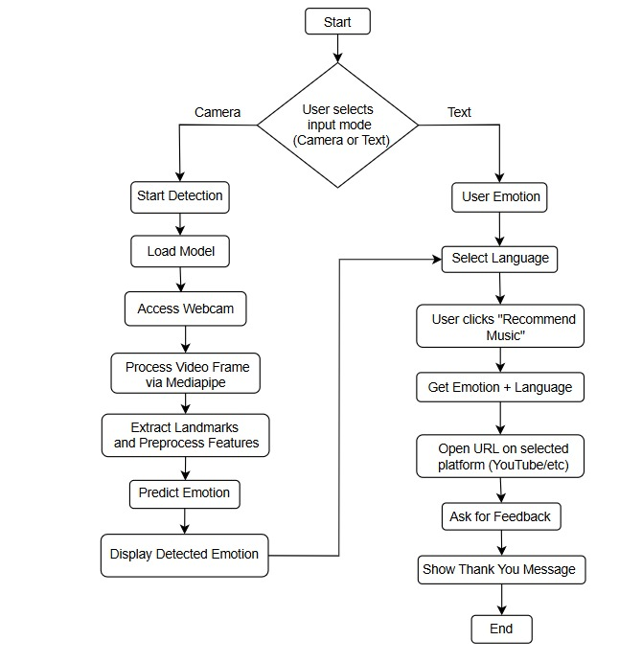
ACTIVITY DIAGRAM:

Slide 19
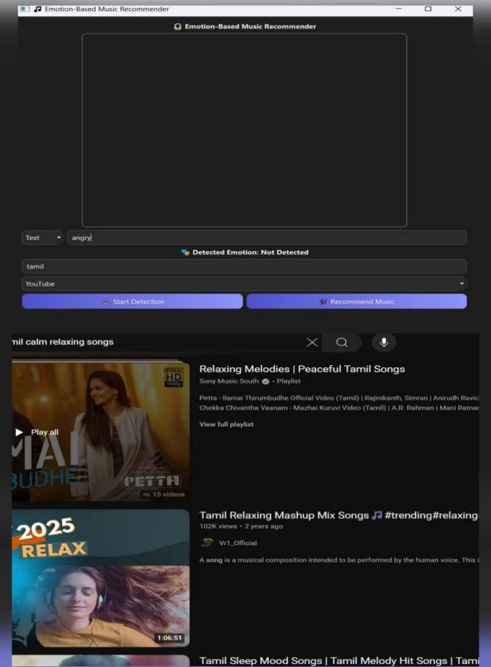
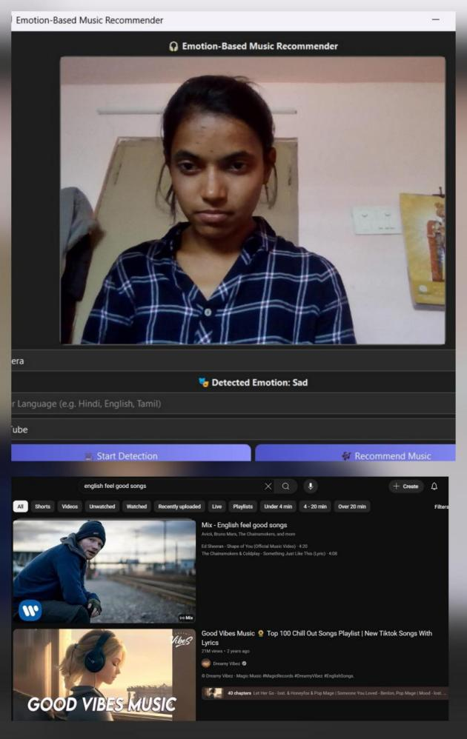
OUTPUT:

Slide 20
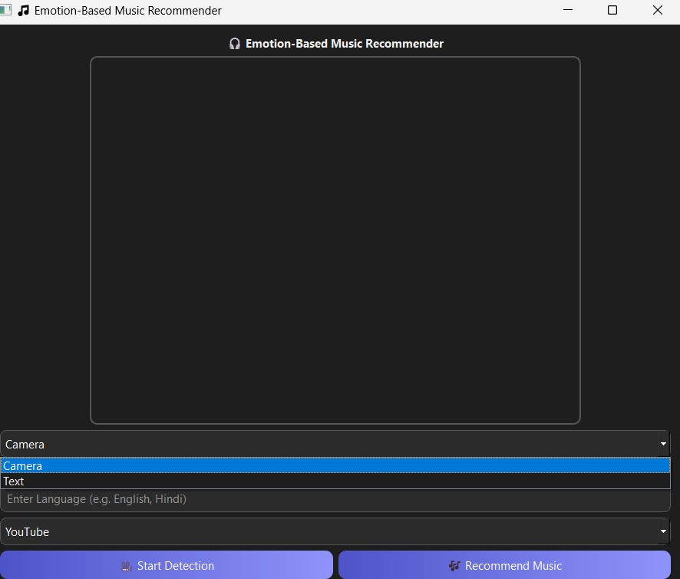
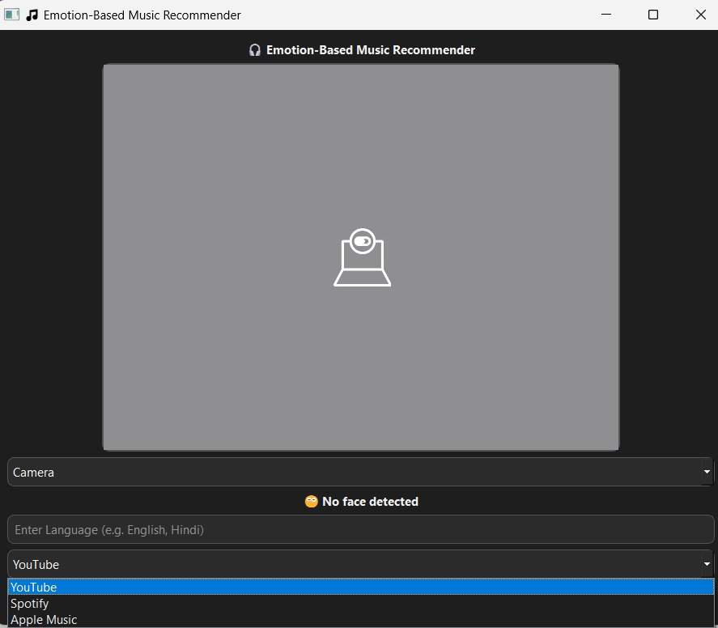

Slide 21
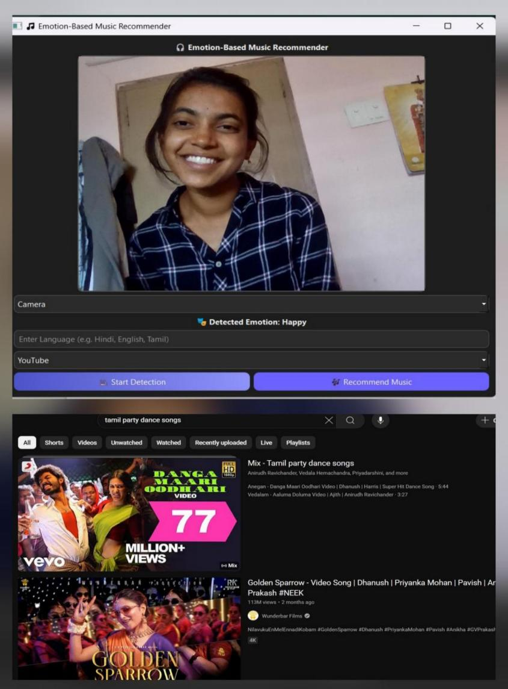

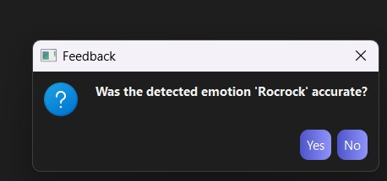

Slide 22
REFERENCES:
KrittrinChankuptarat, etal, “Emotion Based Music Player”, IEEE 2019
conference.
Kim, Y.: Convolutional Neural Networks for Sentence Classification. In:
Proceedings of the 2014 Conference on EMNLP, pp. 1746–1751 (2014).
Tripathi, S., Beigi, H.: Multi-Modal Emotion recognition on IEMOCAP
Dataset using Deep Learning. In: arXiv:1804.05788 (2018).
Teng et al.,”Recognition of Emotion with SVMs”, Lecture Notes in Computer
Science, August 2006.
B.T. Nguyen, M.H. Trinh, T.V. Phan, H.D. NguyenAn efficient realtime
emotion detection using camera and facial landmarks , 2017 seventh international
conference on information science and technology (ICIST) (2017)

Slide 23
THANK YOU

